Slide 1


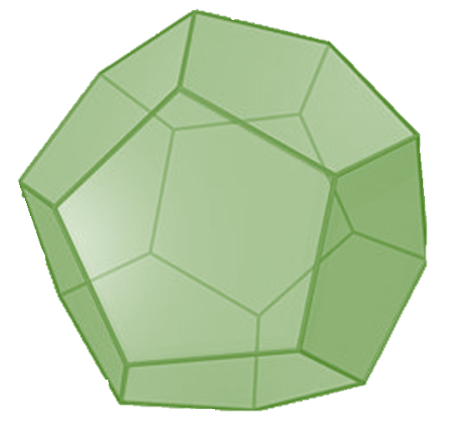


Machine Learning Models Re-usability in Edge Computing Environments
School of Computing Science
Essence: Pervasive &
Distributed Computing
Xenia Skotti
Notes:
Hello! Today I’ll be presenting a novel model reuse framework in the context of edge computing.

Slide 2

Table of Contents
School of Computing Science
Essence: Pervasive &
Distributed Computing
Context
Our Solution
Experimental Setup
Results
Conclusions
Limitations and Future Work
Notes:
But first we will provide some context.
What is edge computing and why do we need to reuse models in that context? Why is it a problem if we don’t.
In general, why would a model reuse framework be useful.
Then we will present our solution and how we’ve tested it in terms of the experimental setup.
What were our results and what are some conclusions we can draw based on them
Lastly, we will discuss some of the limitations of the research and provide guidance on the future work.

Slide 3
What is Edge Computing?
Paradigm where the nodes at the edge of the network both produce and consume data
More efficient to process the data at the edge
Applied in a variety of contexts such as smart homes and smart cities.
Notes:
The combination of the rapid expansion of the Internet of Things (IoT) and the success of cloud computing services have contributed to the emergence of a new computing paradigm, edge computing.
The paradigm essentially calls for processing data at the edge of the network because data are being increasingly produced at the edge of the network making these nodes both data producers and consumers.
So it’s just more efficient to process the data at the edge of the network as well.
The efficiency of the paradigm makes it attractive so it’s been applied in a wide variety of contexts including smart homes and cities.

Slide 4
How to analyse information?
Machine Learning Methods
Notes:
Adoption of edge computing grows -> nodes record more data -> how to analyze information?

Slide 5
What is the problem?
computation
energy consumption
storage
Notes:
using ML methods comes with it's own set of challenges including increased amounts of…

Slide 6
What now?
Reduce the number of models needed to be trained in the first place by reusing existing models.
Notes:
One of the ways to reduce the burden on the network overall, is to reduce the amount of models needed to be trained in the first place by reusing existing models.
This is a form of compute reuse and this is the basis of our framework.

Slide 7
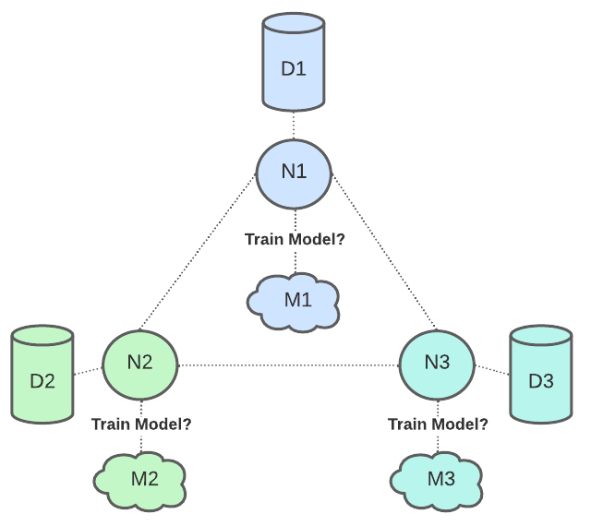
Aim
Notes:
Given a number of nodes and their corresponding datasets we want to decide for which nodes to train a distinct model and for which to reuse one.

Slide 8
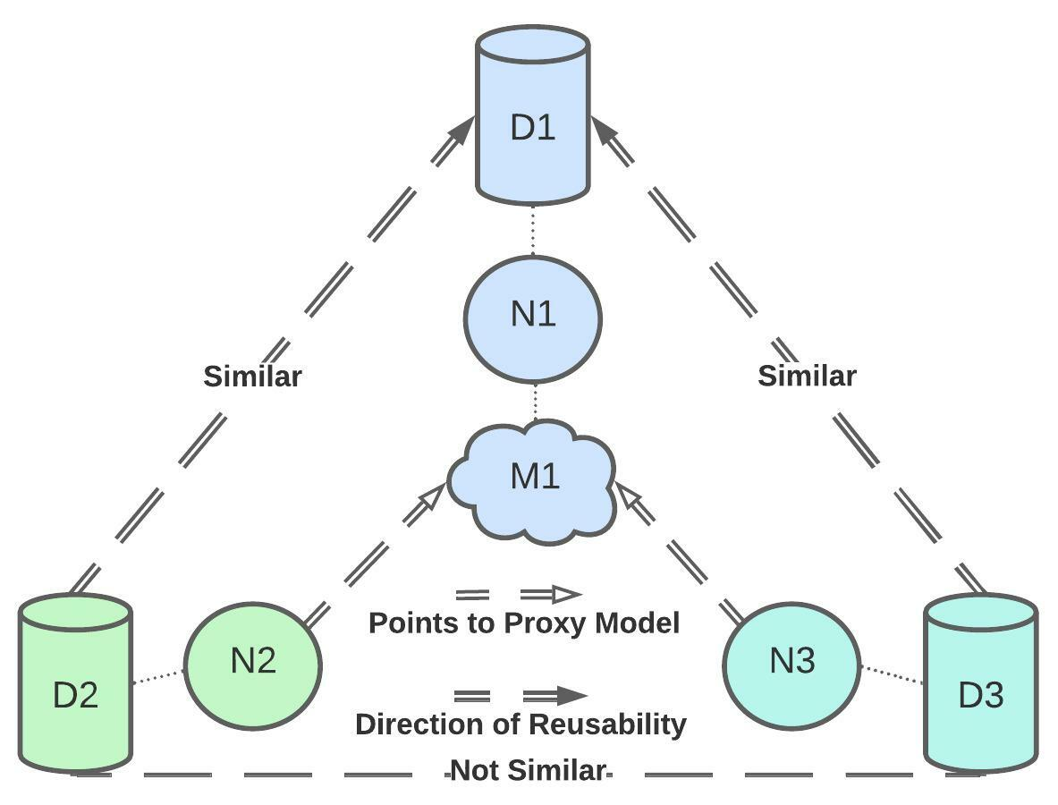
Framework Requirements
Notes:
In order to do that we need to determine which of these datasets are similar and the direction of reusability per pair.
Once we’ve done that we need to unify this information at the network level that is why we’ve proposed a reusability maximizing decision making algorithm.
A reusability maximizing algorithm means that we want to maximize the number of nodes for which we don’t train models for.

Slide 9
Pair Similarity Detector
The similarity detector is based on the Maximum Mean Discrepancy (MMD).
MMD quantifies the mean discrepancy of two data distributions in a kernel space in order to determine if two samples are drawn from different distributions.
The detector compares MMD value of the pair against a threshold we’ve dubbed the Average Similarity MMD (ASMMD) to distinguish between similar and non-similar pairs.
Notes:
So starting off with the pair similarity detector, our detector is based on the Maximum Mean Discrepancy MMD for short.
MMD is a statistic that quantifies the mean discrepancy of two data distributions in a kernel space in order to determine if two samples are drawn from different distributions.
Our detector compares MMD value of the pair against a threshold we’ve dubbed the Average Similarity MMD (ASMMD) to distinguish between similar and non-similar pairs.

Slide 10
Direction of Reusability Detector
The direction of model reusability detector is based on the inlier data space overlap.
A predictor for inlier space overlap is the probability of correctly predicting the non-native inliers of a model.
We used the One-class Support Vector Machines (OCSVM) to determine which points are inliers.
Given two nodes and their corresponding OCSVM models, we can use each OCSVM model to predict the other node's inliers and then find the probability of detecting them, hence their overlap.
Notes:
In other words, what is the overlap between the inlier points of two datasets, the native and non-native one with regards to the inlier detection model.
The reason behind using inliers to determine the overlap is that any dataset is expected to have a few outliers and hence some filtering needs to be applied anyway.
Simultaneously, this can also be leveraged to determine the direction of reusability.

Slide 11
Experimental Setup
Datasets:
GNFUV Unmanned Surface Vehicles Sensor Data Set (GNFUV)
UCI Bank Marketing Dataset (BM)
ML Models:
Support Vector Regression (SVR)
Logistic Regression (LR)
We used Grid Search to optimise the parameters of the models.
We experimented with a linear and non-linear kernel for regression, standardised and non-standardised version of the regression data and a balanced and non-balanced version of the classification data.
Notes:
The most common ML problems revolve around making a prediction of either the category or a quantity based on the data input.
These problems are also known as classification and regression respectively.
So we focused on these when we tested our framework.
The GNFUV dataset is a regression dataset and the BM Dataset a classification one.
We’ve used Support Vector Regression and Logistic Regression for regression and classification respectively.

Slide 12
Model Reusability Metrics
Speedup: the gain in performance by avoiding to train some of the models
Precision: the number of times the framework is correct. Assessed for each component individually and combined.
Notes:
Investigating the effectiveness of the framework, requires that we examine two aspects:
the speedup: we benefit from when we avoid training models for some nodes in the network,
and the precision of the framework in terms of the recommendations it makes.
We've defined both speedup and precision in the context of model reusability.

Slide 13
Results: Precision
Regression:
The framework performs better on the original data across all three levels of precision with 0.77 combined precision at threshold 0.8 and a drop of 15% for standardised ones.
The threshold simply states how close to the true model performance is the proxy model performance.
The linear kernel is better suited for the original data, while the opposite is true for standardised data even though this difference is not large.
The rbf kernel models have higher performance on their native datasets compared to linear ones, but nevertheless have higher discrepancy. On average linear models provide better results.
Notes:
For regression, the framework performs better on the original data across all three levels of precision. The framework achieves 77% combined precision on the original data and 52% for standardised ones at threshold 0.8.
The threshold simply states how close to the true model performance to the proxy model’s performance. So in our case, 77% of the time the proxy model will give as good results as the true model with a maximum difference of 20%.
Analysis of the combined precision results per kernel shows that the linear kernel is better suited for the original data, while the opposite is true for standardised data even though this difference is not large.
The rbf kernel models have higher performance on their native datasets compared to linear ones, but nevertheless have higher discrepancy. On average linear models provide better results.

Slide 14
Results: Precision
Classification:
The combined precision is extremely high regardless of whether we distinguish between the configurations or not, if we are not strict.
If we are strict this performance drops at 0.55 on average and this is a direct reflection of the OCSVM precision.
Considering how good the performance is overall, the real combined precision of the framework is the one given by the non-strict measure.
Non-strict and strict refers to whether we allow a 0.05 margin of error on the direction of reusability detector.
Notes:
The MMD precision is perfect across configurations.

Slide 15
Results: Speedup
Overall, the speedup of the framework for the particular datasets used for regression and classification are 26% and 29% to 41% respectively .
The GNFUV dataset has four nodes and on average there is one good pair for reusability regardless of the data configuration hence one node's model is not trained.
The nodes of the BM dataset were derived from two clusters so ideally we would only train two models. Nevertheless the results are lower than this average case due to the fact we use samples of the dataset hence the true reusability differs from sample to sample.
Hence, for both the classification and regression case we can argue that the framework if effective in identifying the true number similar pairs.

Slide 16
Conclusions
Presented a novel online model reuse framework in edge computing.
The framework considers all possible pairs of nodes in the network and infers which are good reusability pairs using MMD as well as which of the two nodes' model can be used as a replacement model for the other per pair.
The node model that is chosen to be reused in each pair is the one with the highest inlier data space overlap.

Slide 17
Conclusions
Proposed an algorithm which given the results of the framework so far, it can maximise the number of nodes which use reused models along with a list of potential replacement models.
Experiments in the context of both regression and classification indicate the framework achieves good precision.

Slide 18
Limitations & Future Work
Extend the evaluation of the framework to check it’s compatibility with more domain models and data configurations.
Amend the framework to preserve user privacy.
Consider more than one outlier detection model.
Define decision making algorithms which can produce either the performance optimal or partially optimal solution.
Notes:
Results are preliminary.
Our framework considers only one domain model per problem type and a limited data configuration.
Also the framework, does not preserve user privacy and only considers one outlier detection model.
As we’ve talked about before, the decision making algorithm we’ve proposed maximises reusability so in the future…

Slide 19

Thank you!
School of Computing Science
Essence: Pervasive &
Distributed Computing
Questions?
Email me at: 2299606s@student..gla.ac.uk
http://www.dcs.gla.ac.uk/essence/

